Slide 1
Classification, Prediction, Clustering, Ranking, and Outlier Detection

Slide 2
Classification
Classifier:
attributes (X) → categorical class label (Y)

Slide 3
Classification
Classifier:
attributes (X) → categorical class label (Y)
The attributes of email spam are (X)
The attributes of a PhD candidate are (X)
→
Is (Y) email spam?
Should student (Y) be admitted to the PhD program?
→

Slide 4
Classification
Classifier:
attributes (X) → categorical class label (Y)
?

Slide 5
Classification
Techniques: supervised machine learning
Classifier is trained using labeled training data to identify unlabeled data.

Slide 6
Classification
Applications: loan approval, spam detection, clinical diagnosis, political leaning, Web page categorization

Slide 7
Classification
Applications: loan approval, spam detection, clinical diagnosis, political leaning, Web page categorization

Slide 8
Classification
Applications: loan approval, spam detection, clinical diagnosis, political leaning, Web page categorization

Slide 9
Classification
Applications: loan approval, spam detection, clinical diagnosis, political leaning, Web page categorization

Slide 10
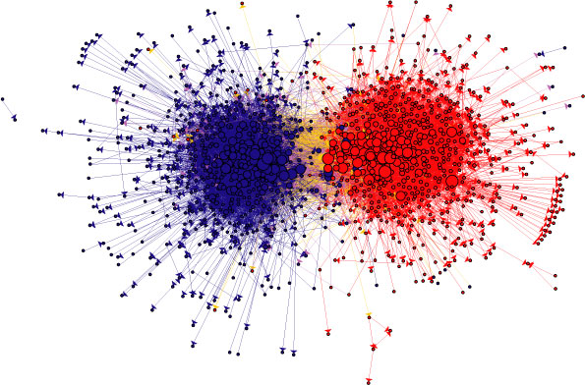
Classification
Applications: loan approval, spam detection, clinical diagnosis, identify political leanings
source: Adamic and Glance, The political blogosphere and the 2004 US election: divided they blog,

Slide 11
Prediction
Regression:
attributes (X) → numerical outcome (Y)
When (X) market conditions occur
When player (X) average is above 1.5 goals/game
→
Stock will increase in price by (Y) dollars
Team will score at least (Y) goals in their next game
→

Slide 12
Prediction
Regression:
attributes (X) → numerical outcome (Y)
?
?

Slide 13
Prediction
Techniques: supervised machine learning, regression analysis, time series analysis

Slide 14
Prediction
Applications: recommender systems, stock market prediction, weather forecasting and election prediction.
“How would a particular person rate this movie?”

Slide 15
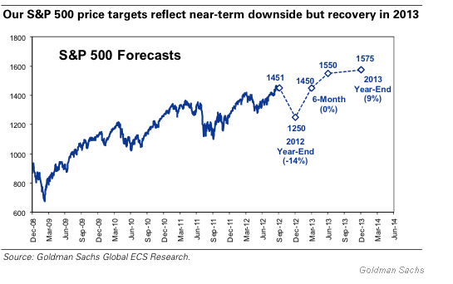
Prediction
Applications: recommender systems, stock market prediction, weather forecasting and election prediction.
Source: https://seekingalpha.com/article/926141-2-s-and-p-500-forecasts-for-2012minus-13

Slide 16
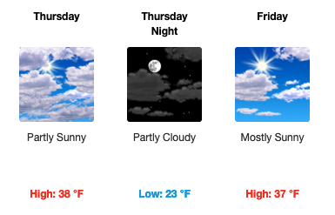
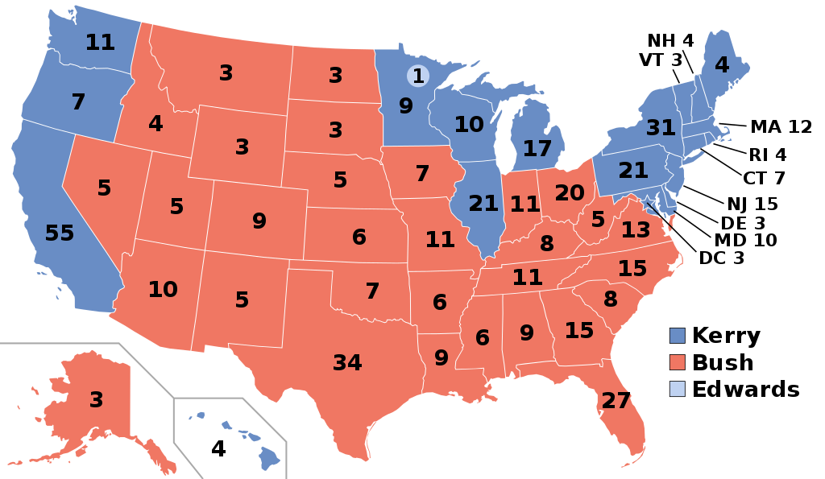
Prediction
Applications: recommender systems, stock market prediction, weather forecasting and election prediction.
public domain
www.weather.gov

Slide 17
Clustering
Similar to classification, but no predefined classes or training data available

Slide 18
Clustering
Techniques:
Unsupervised machine learning: Model uses unlabeled data examples for training.

Slide 19
Clustering
Techniques:
Unsupervised machine learning: Model uses unlabeled data examples for training.
Network analysis: A cluster of nodes is known as a “community.”

Slide 20
Clustering
Applications: community extraction (social networks), topic extraction (text), market segmentation, and taxonomies.

Slide 21
Clustering
Applications: community extraction (social networks), topic extraction (text), market segmentation, and taxonomies.

Slide 22
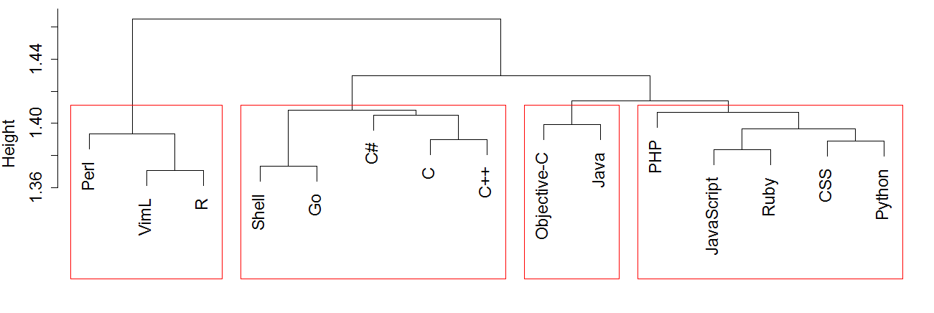
Clustering
Applications: community extraction (social networks), topic extraction (text), market segmentation, and taxonomies.

Slide 24
Ranking
Find a ranked order of data objects
>
>
>
>
>...
...

Slide 25
Ranking
Techniques:
Machine learning: Called “learning to rank” when applied to ranking.

Slide 26
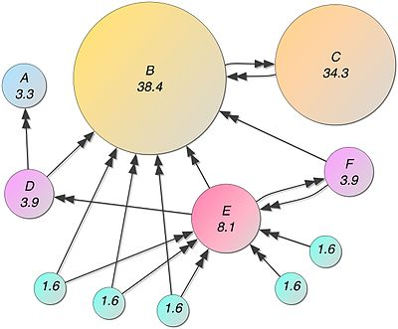
Ranking
Techniques:
Machine learning: Called “learning to rank” when applied to ranking.
Network analysis: Google’s “PageRank” algorithm is based on network analysis.
Source: https://en.wikipedia.org/wiki/PageRank

Slide 27
Ranking
Applications: Web search, recommender systems, bibliometrics, social networks (e.g., opinion leaders), and the NBA draft.

Slide 28
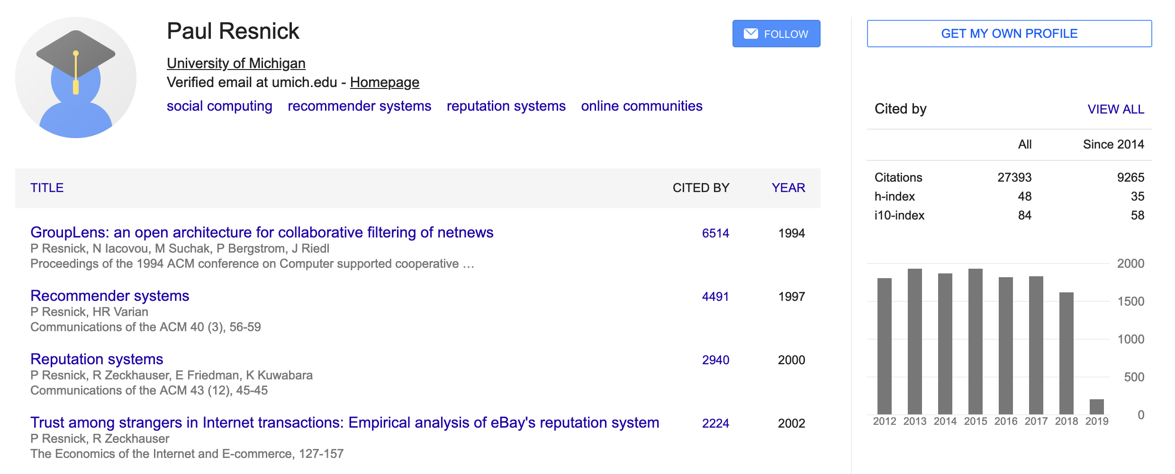
Ranking
Applications: Web search, recommender systems, bibliometrics, social networks (e.g., opinion leaders), and the NBA draft.
Notes:
Use Paul Resnick’s

Slide 29
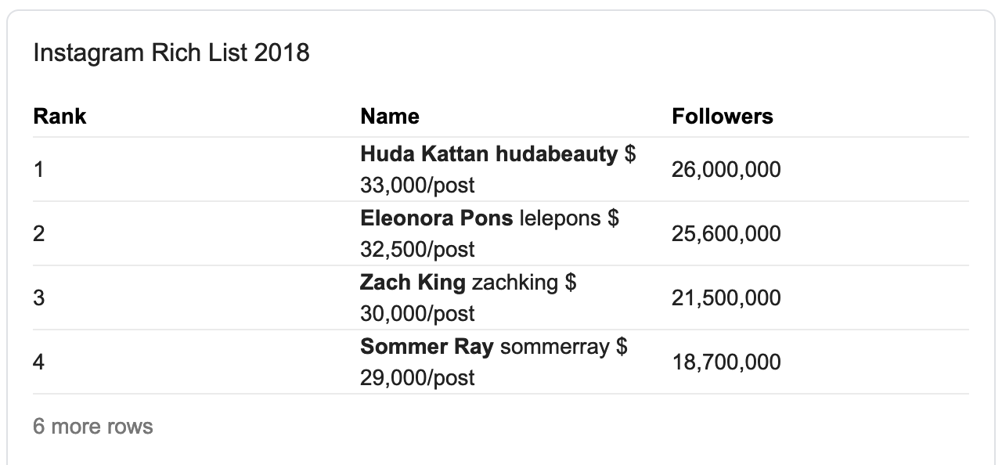
Ranking
Applications: Web search, recommender systems, bibliometrics, social networks (e.g., opinion leaders) and the NBA draft.
source: Google search “social media influencers 2018”

Slide 30
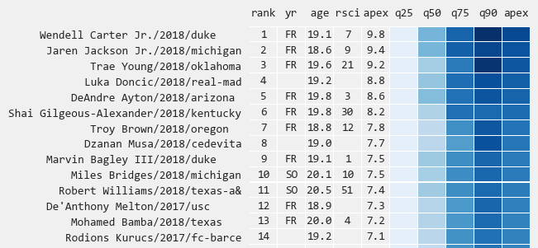
Ranking
Applications: Web search, recommender systems, bibliometrics, social networks (e.g., opinion leaders) and the NBA draft.
source: http://www.tothemean.com/2018/06/10/nba-draft-2018.html

Slide 31
Outlier Detection
Find set of objects that are considerably dissimilar from the remainder of the data
Usually coupled with trend analysis

Slide 32
Outlier Detection
Techniques: signal processing, time-series analysis, and also clustering.

Slide 33
Outlier Detection
Applications: fraud detection, network security, mining software bugs, event detection, and clinical diagnosis.

Slide 34
Outlier Detection
Applications: fraud detection, network security, mining software bugs, event detection, and clinical diagnosis.

Slide 35
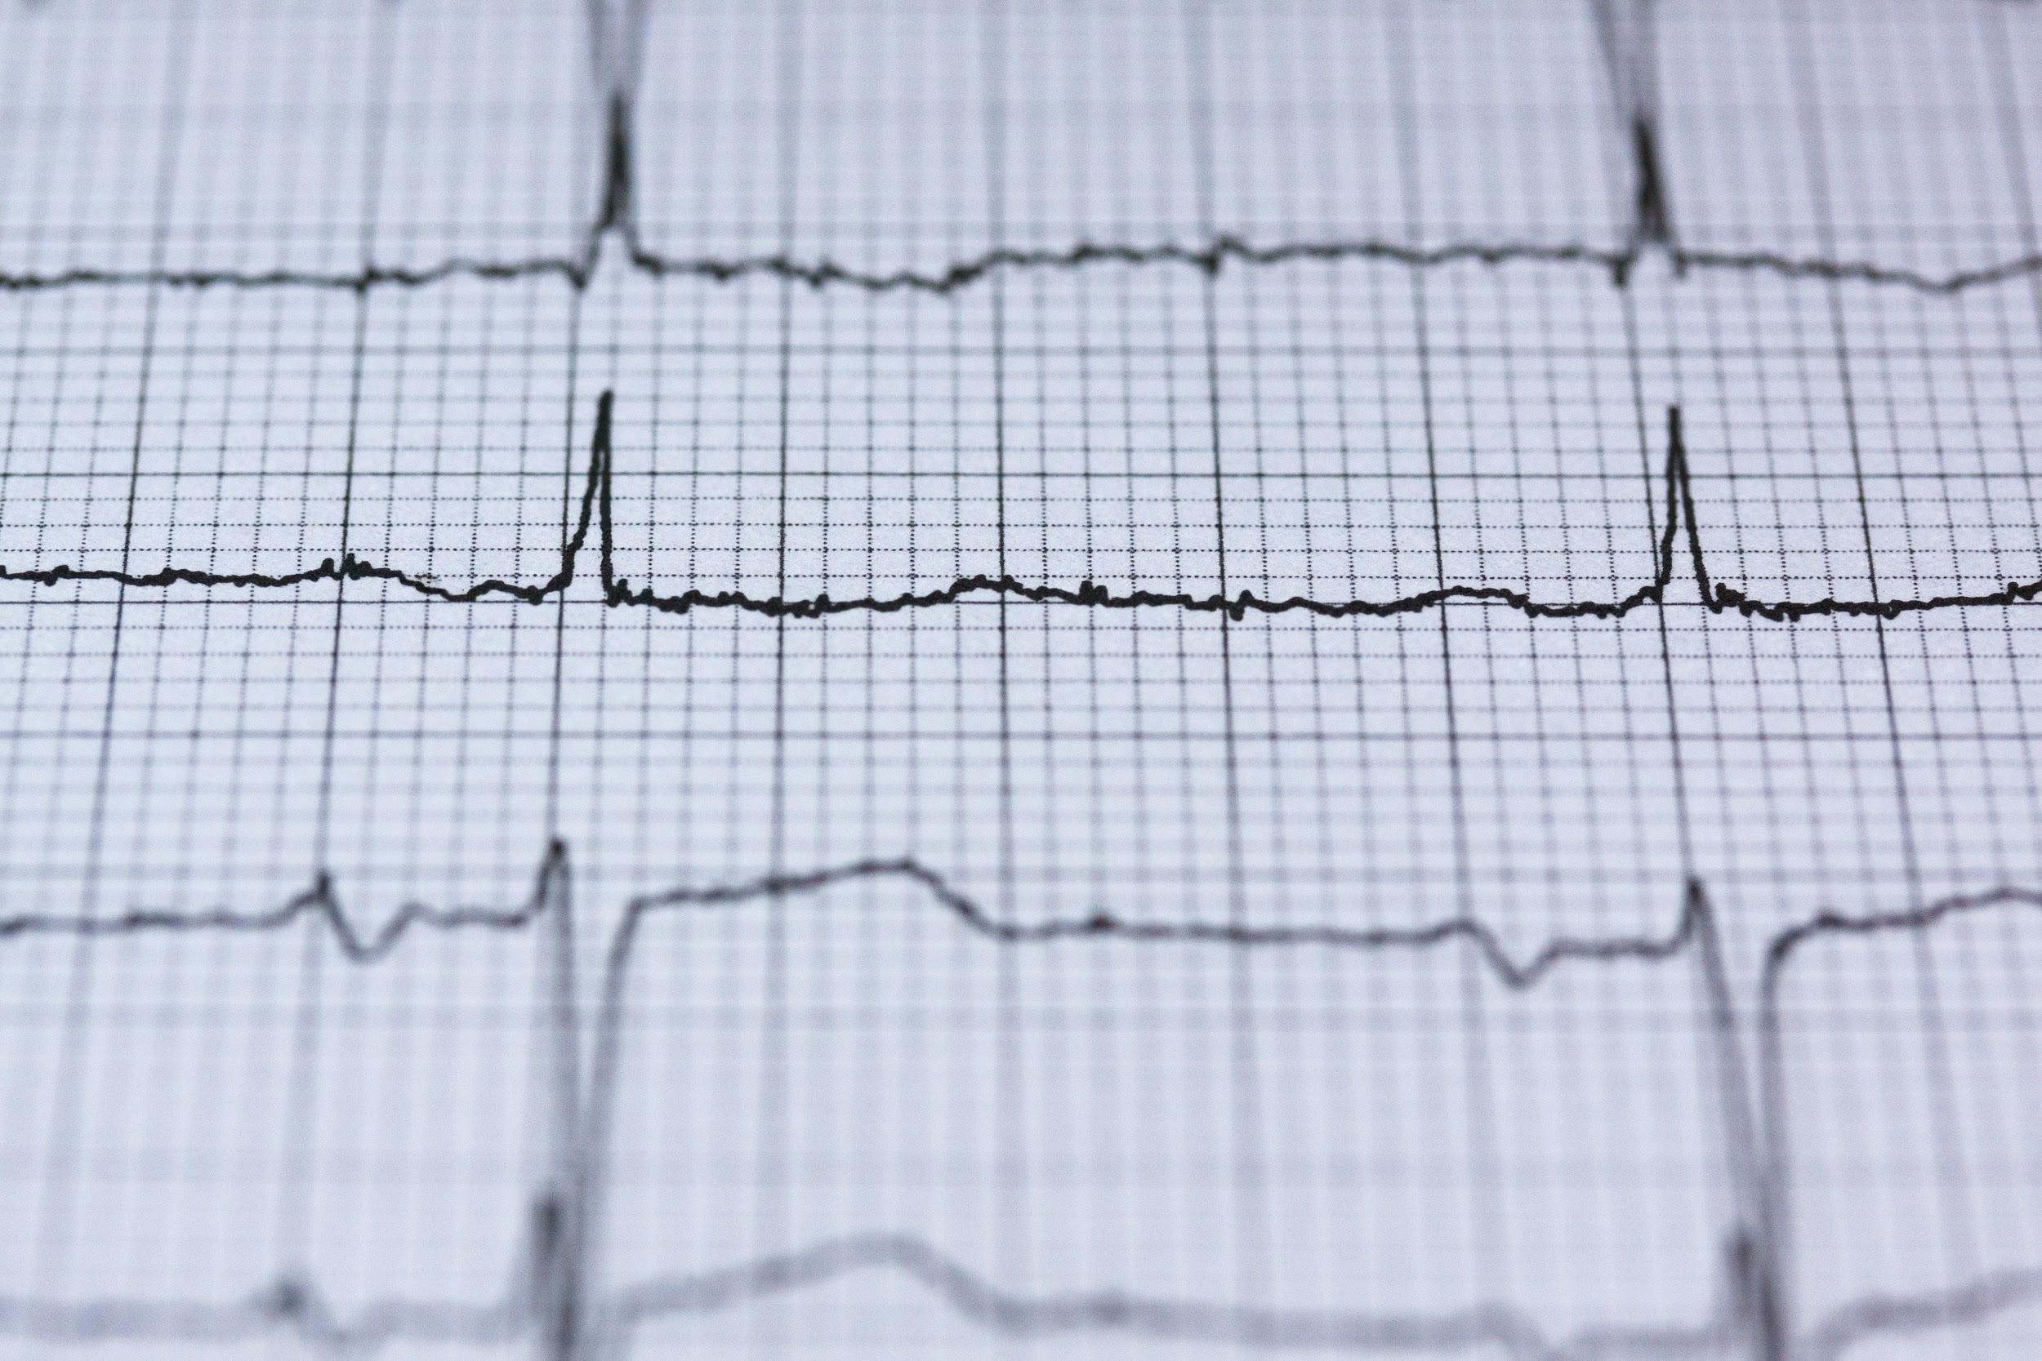
Outlier Detection
Applications: fraud detection, network security, mining software bugs, event detection, and clinical diagnosis.

Slide 36
What you should know
Basic functionalities of data mining
How functionalities differ from each other

Slide 37


School of Information, University of Michigan
Qiaozhu Mei
School of Information
All Content © Presenter

